Slide 1

Exploration of Fortune Global 500 fluctuation
Jiaxu Luo

Slide 2




Slide 3
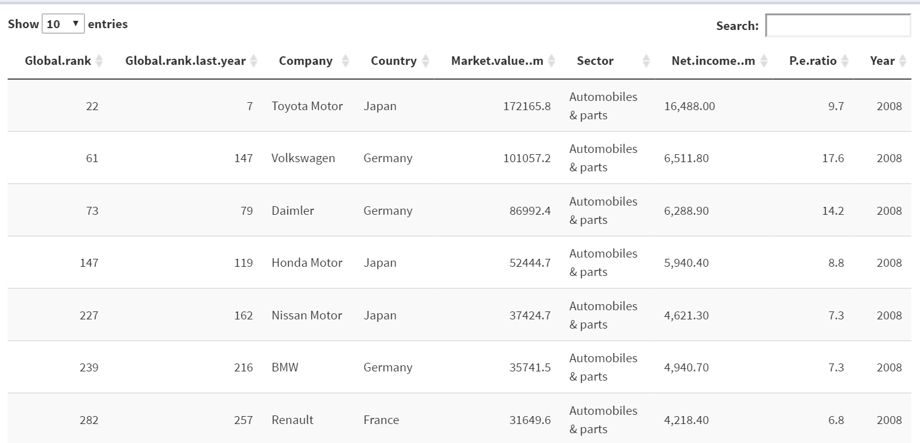
Dataset

Slide 4
Questions
(1)What is the geographical distribution of an industry of interest in country level in a specified year
(2)What is the market value composition of an industry of interest in a specified year
(3)What is the comparison of market value and P/E ratio between companies in a specified industry and specified year

Slide 5
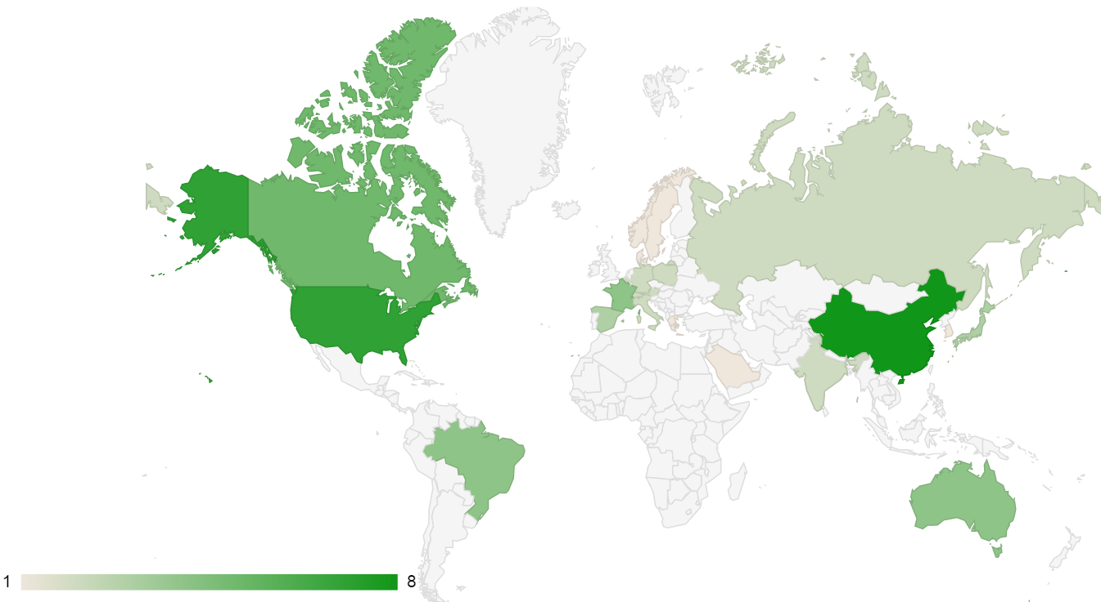
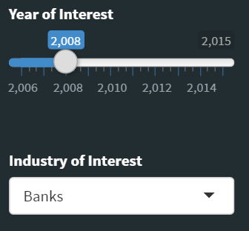
What is the geographical distribution of an industry of interest in country level in a specified year
Number of Fortune 500 by industry

Slide 6
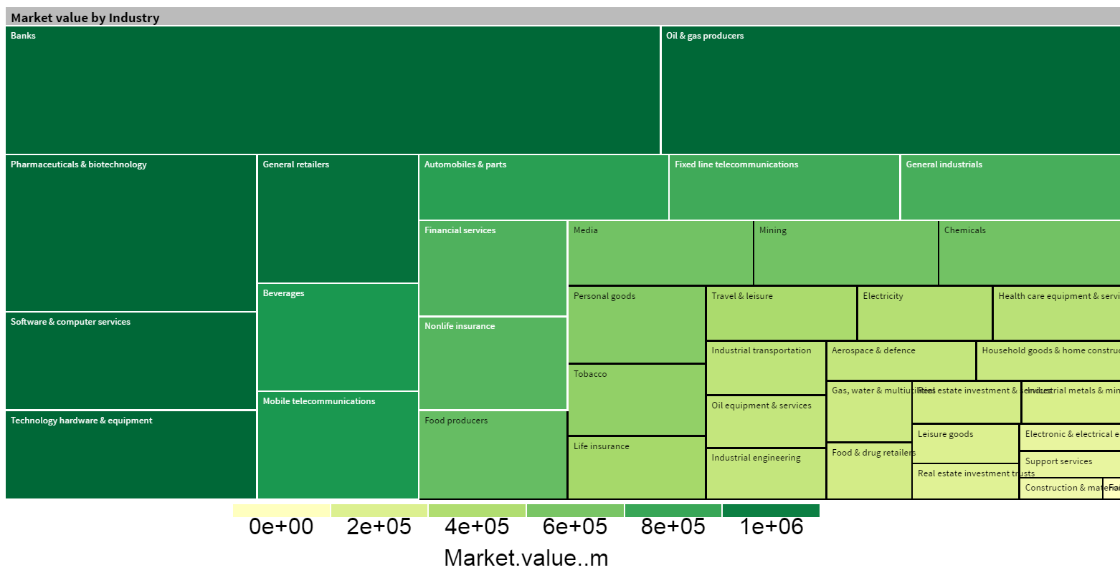
What is the market value composition of an industry of interest in a specified year
Market.value(m) by industry

Slide 7
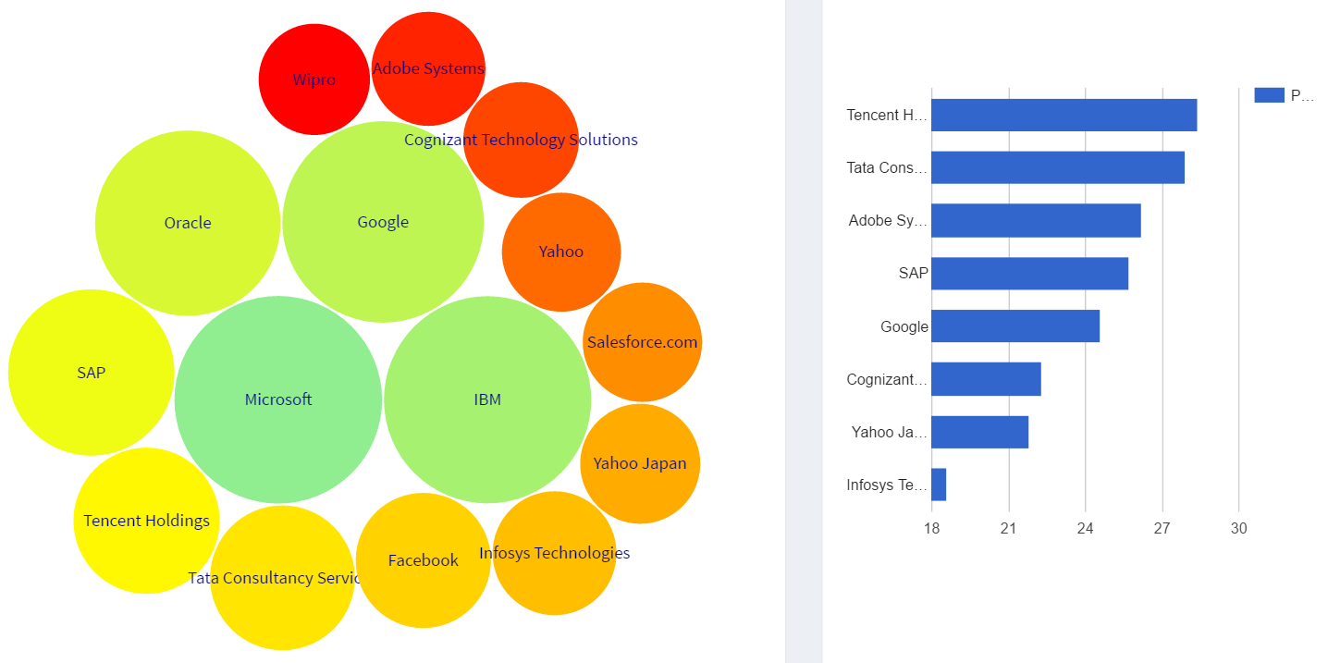
What is the comparison of market value and P/E ratio between companies in a specified industry and specified year
Market.value(m) of companies
P.e.ratio of companies

Slide 8


